Slide 1

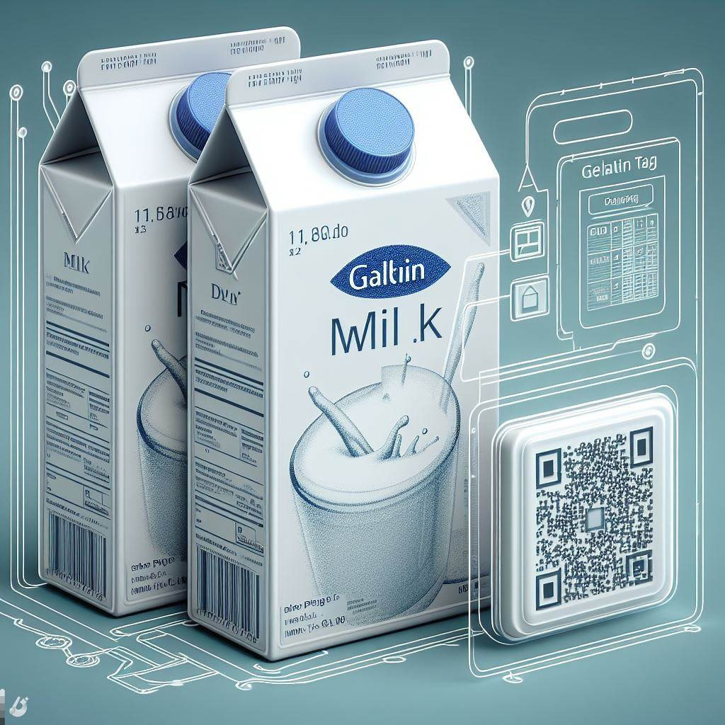
INTELLIGENT PACKAGING
GROUP 4

Slide 2



TABLE OF CONTENT
-Idea behind the innovation
-Finding Resources
-Business Model
-Venture Creation
-Knowledge management
-Challenges

Slide 3

INTELLIGENT PACKAGING

Slide 4





Idea behind our innovation
SOLUTION
Intelligent packaging
Gelatin tag resembles product’s biological structure and its preservability.
PROBLEM
Food loss
1/3 of edible food is thrown away every year.
Many products that passes expiration date are still good.

Slide 5




Finding Resources
Business Model Elements
of our Innovation
Potential sources of funding (Internal)
Strategic alliances
(partners, open innovation)

Slide 6









Value Proposition:
Accurate Freshness Checks & Real-Time Monitoring
Reduced Food wastage, & more savings
Great aid for visually impaired
Increased Brand Value for companies involved
Partners
HID Global for sensors in packages
Business Model
Target Market:
Business involved in distribution and supply of food and beverages
Costs
Major costs: Embedding sensors into packages

Slide 7




Shared Profits, Funding,
Losses, Works, Resources, Assets & Capabilites
Larger Market Penetration
& Flexibility
Strategic
Alliance
Joint
Venture
Less Resources & costs
integrating sensor technology
for intelligent packaging
Funding
Joint Venture Sales & Revenue
Joint Company Investments

Slide 8


Knowledge Management
Explicit knowledge
Tacit Knowledge

Slide 9
WHY WOULD I WANT THIS?

Slide 10
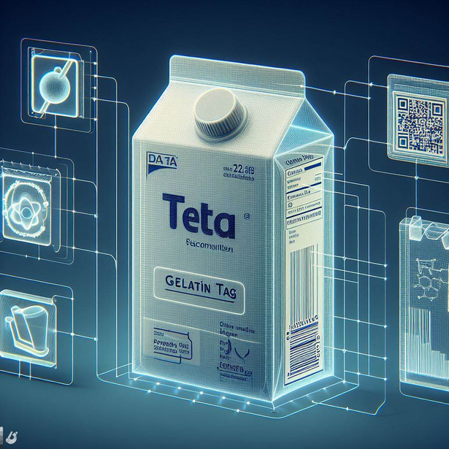






COMPATIBLE
RELATIVE ADVANTAGE
USER FRIENDLY

Slide 11


FOOD LEGISLATION

Slide 12

THANK'S FOR LISTENING
Any questions?

